Slide 1
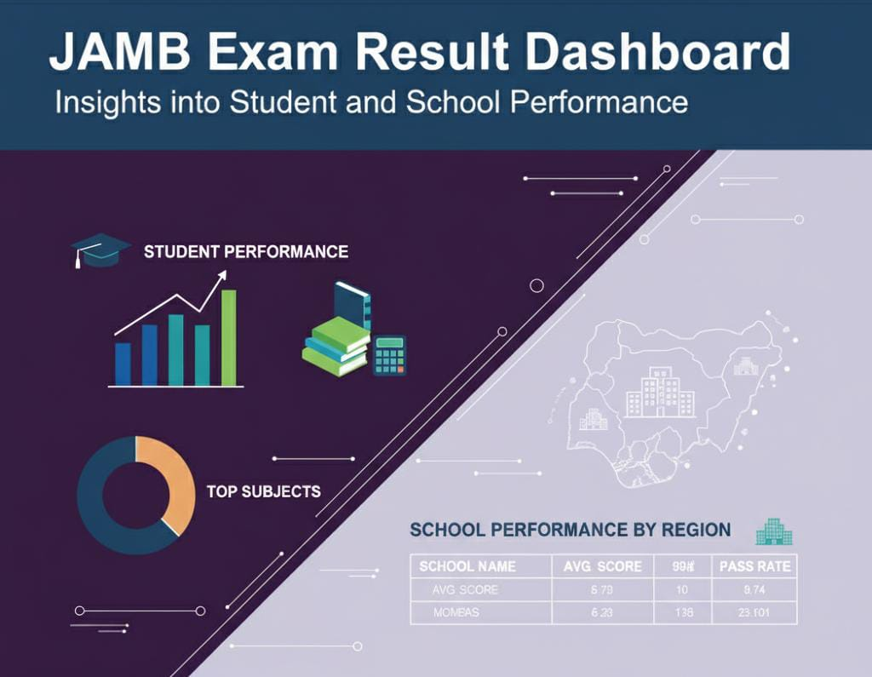
JAMB Exam Result Analysis — Insights into Student and School Performance
NAME: ADELEKE ADESEWA VICTORIA
DATE: 10TH OF NOVEMBER, 2025.

Slide 2
Objectives and Desired outcomes:
To identify trends in students’ JAMB scores across various demographics such as gender, school type, and parental education level.
To compare average JAMB scores and pass rates across different school types and locations (urban vs. rural).
To support policymakers, educators, and school administrators in making informed decisions to improve overall academic performance.

Slide 3
Data overview:
The dataset was obtained from Kaggle and the dataset contains information about students’ academic and background attributes designed to understand the factors influencing JAMB examination outcomes.
Student Demographics: Identifies gender distribution and age patterns among students.
Academic Performances: Represents students achievement and readiness for higher education.
School Information: Describes characteristics and environs of schools.
Parental and Socioeconomic Factors: It highlights the family backgrounds of the students and its influence on the performance on the students.
Others: Measures the accessibility of students to the school environs and its effects on attendance and academic outcomes.

Slide 4
Methodology:
Data preparation and Cleaning: The Data cleaning was conducted in both Microsoft SQL Server and Power BI to ensure accuracy in the final results. For example:
^{Column Renaming}
^{Rounded Numeric values}
^{Created calculated measures.}
There were no duplicates present.
There were missing values present.
Their Data types were accurate.
^{Link to the Dashboard:}

Slide 5
Methodology:
Data preparation and Cleaning: The Data cleaning was conducted in both Microsoft SQL Server and Power BI to ensure accuracy in the final results. For example:
^{Column Renaming}
^{Rounded Numeric values}
^{Created calculated measures.}
There were no duplicates present.
There were missing values present.
Their Data types were accurate.

Slide 6
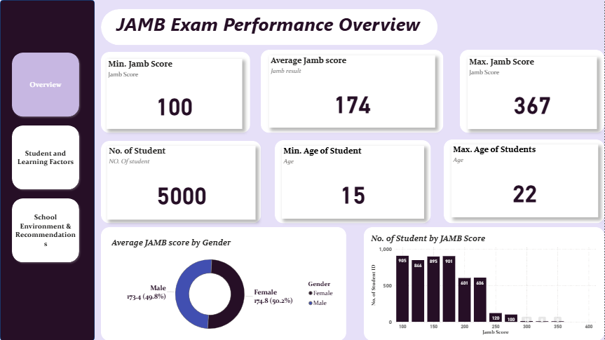

Slide 7
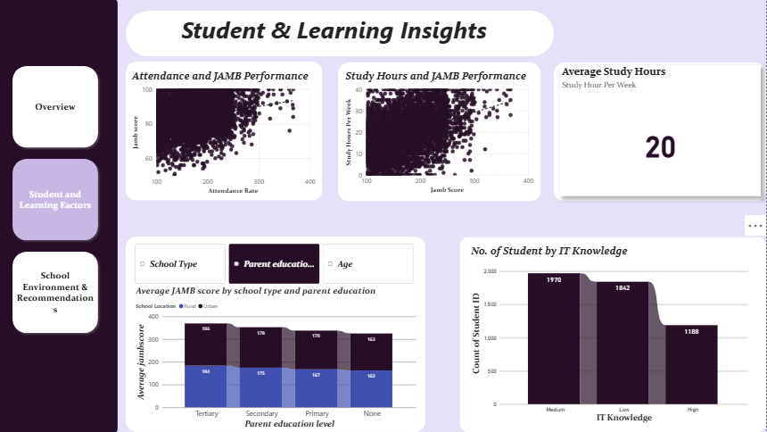

Slide 8
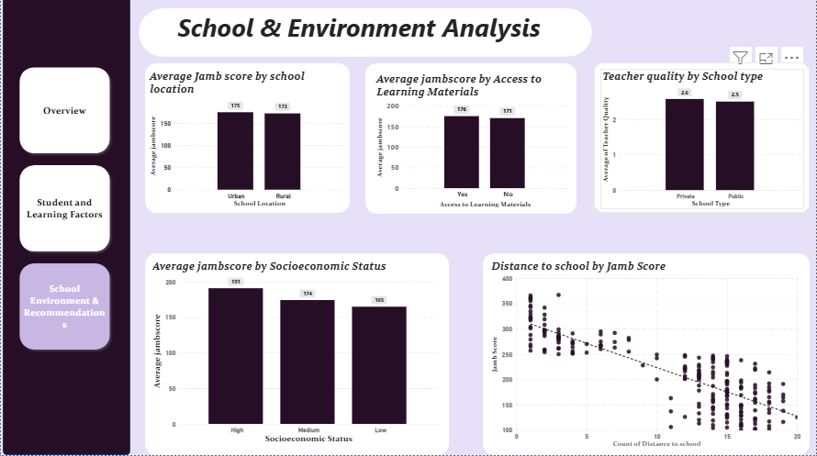

Slide 9
Key findings:
Overall Student Performance:
The average JAMB score across all students was approximately 174.
Majority of students scored within the 150–200 range(1,796).
Only a small proportion achieved scores above 250, suggesting limited high performers.

Slide 10
Key findings:
Gender and Academic Performance:
Female students had a slightly higher average JAMB score than Male students, though the difference was minimal.
This indicates comparable performance between genders, showing that gender was not a strong determinant of success.

Slide 11
Key findings:
Influence of School Type:
The average JAMB score for private school students was higher than that of the public school students.
This may reflect differences in learning resources, teacher quality, or academic support.

Slide 12
Key findings:
Impact of School Location:
Urban schools had a slightly higher average JAMB score than rural schools, highlighting a geographical performance gap.
Students in urban areas may benefit from better access to educational infrastructure and internet connectivity.

Slide 13
Key findings:
Impact of other factors:
Students whose parents attained tertiary education consistently scored higher in JAMB compared to those whose parents had no formal education.
There was a negative relationship between distance to school and JAMB score — students who traveled longer distances generally performed worse.
Students from higher socioeconomic backgrounds and those with strong IT knowledge tended to perform better.
Schools with higher attendance rates recorded better average scores, confirming the positive impact of consistent classroom participation on exam results.

Slide 14
Recommendation:
Strengthen Support for Underperforming Schools
Public and rural schools should receive more support to close the performance gap with urban and private schools.
Promote Equal Learning Opportunities
Since female students performed slightly better, academic schemes should be made to sustain female academic engagement while encouraging male students to match their performance.
Encourage Parental Involvement
Since students with highly educated or involved parents perform better, parental engagement campaigns can make a significant difference.
Reduce Distance Barriers to Learning
Establish more community-based learning centers or improve transportation options for students who live far from school.
Leverage Technology and Digital Literacy
Promote IT skill development among students, as strong IT knowledge correlated with higher JAMB scores.
Others
Provide scholarships, grants, or free tutorial programs for students from low socioeconomic backgrounds.
Students with higher attendance rates performed better , so, establish attendance reward systems and early interventions for absentee students.

Slide 15
Conclusion:
This analysis of JAMB exam results provides valuable insights into how student, school, and parental factors influence academic performance.
In all, the data highlights that improving access, equity, and support systems can lead to stronger academic outcomes. By applying data-driven strategies like enhancing rural education, promoting digital literacy, and engaging parents, education higherups can bridge the performance gap and foster excellence across all student groups.
^{THANK YOU FOR LISTENING!}

